Slide 1
AMANAH PROFILE OF VALOR & VICTOR TRILOGY
AMANAH OF OZ
AMANAH’S ODYSSEY
AMANAH’S OPUS
© Group K LTD. AMANAH NEIL KEENAN neilkeenan.com

Slide 2
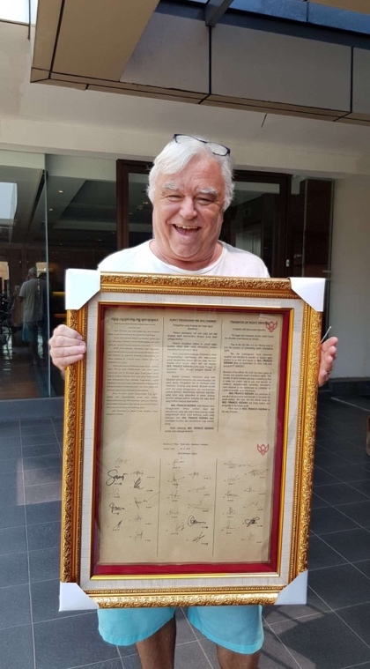
THE ONE AMANAH NEIL KEENAN
OF INDONESIA

Slide 3
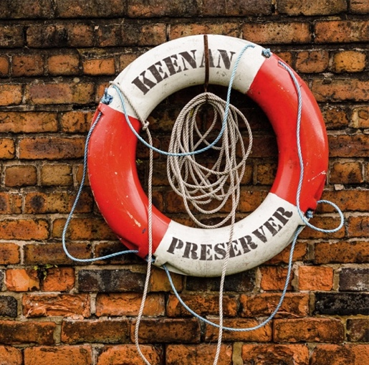
AMANAH NEIL KEENAN IS STILL STANDING
Elton John – I’m Still Standing
After over 12+ Assassination attempts on my life, rumors abound that I am “dead” so why should I be so concerned?
I will tell you why. I am concerned, because I have so many people that I care about, and I cannot go anywhere until I complete what I started.
I am concerned, because I have so many dear friends that would be heartbroken should something happen to me. I am concerned, because damn it, I do not want to lose the person I love nor my son… Thaass why!
I want to enjoy everything we have accomplished after this is over with and begin to really live again. Finally, I want to see the Cabal turn over their sword to us, so count on me staying for a while. Neil Keenan

Slide 4

AMANAH’S ODYSSEY I CALL TO ADVENTURE: 2008-2012

Slide 5
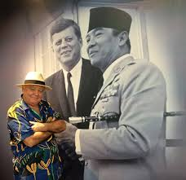
AMANAH’S ODYSSEY I CALL TO ADVENTURE: PLAYLIST SONG
May the Road Rise Up To Meet You - Irish Blessing Song

Slide 6
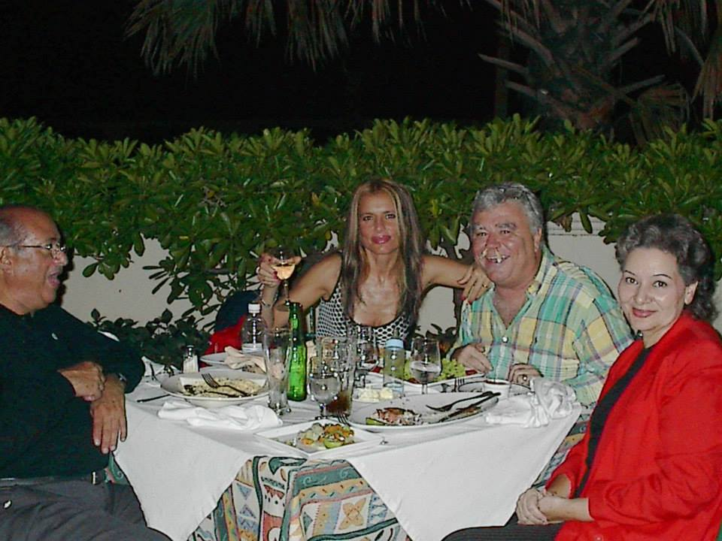
AMANAH’S ODYSSEY I CALL TO ADVENTURE: TRILLION DOLLAR LAWSUIT
International Businessman Neil Keenan and his wife Sonja having dinner with Henry Lopez - Estudio de Abogados Lopez-Penha y Contin with his wife Dejanera in Dominican Republic

Slide 7
AMANAH’S ODYSSEY I CALL TO ADVENTURE: 2008-2010

Slide 8
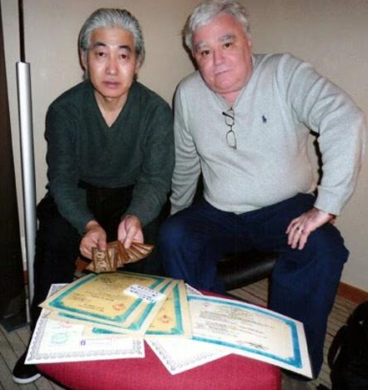
AMANAH’S ODYSSEY I CALL TO ADVENTURE: POA OF GOLDEN DRAGON FAMILY
FINANCIAL INSTRUMENTS 2008
Akihiko Yamaguchi and Neil Keenan with DFFI

Slide 9
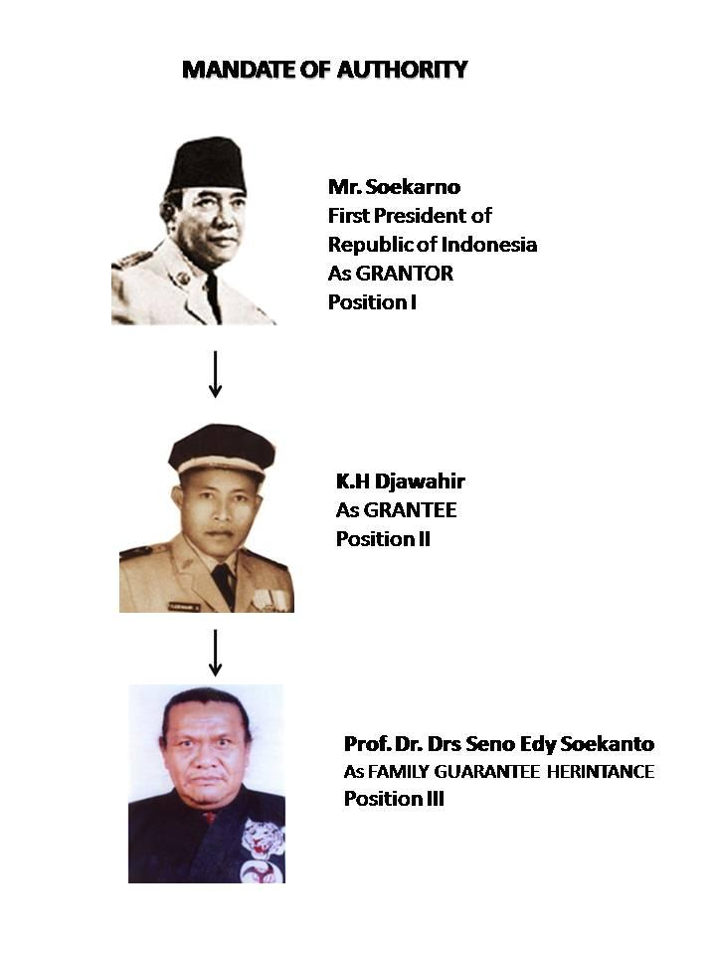
AMANAH’S ODYSSEY I CALL TO ADVENTURE: SOEKARNO MANDATE OF AUTHORITY
Mandate of Authority of
Family Guarantee Heritance

Slide 10
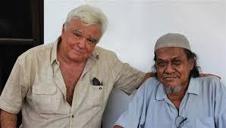
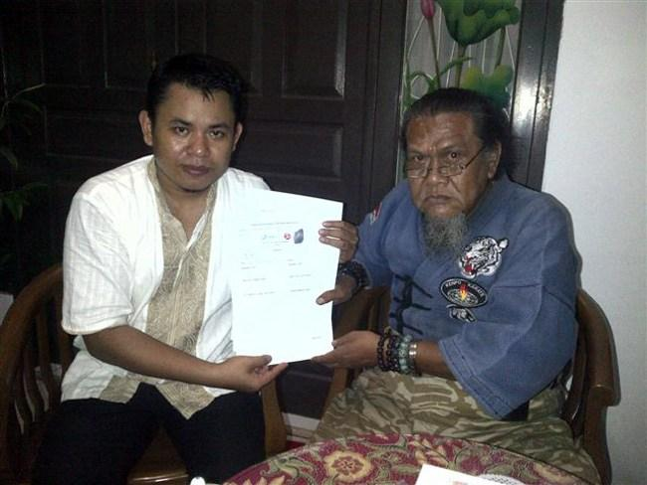
AMANAH’S ODYSSEY I CALL TO ADVENTURE: TRILLION DOLLAR LAWSUIT
Dr. Seno Edy Soekanto, Ledger Holder
Family Heritance Guarantee

Slide 11
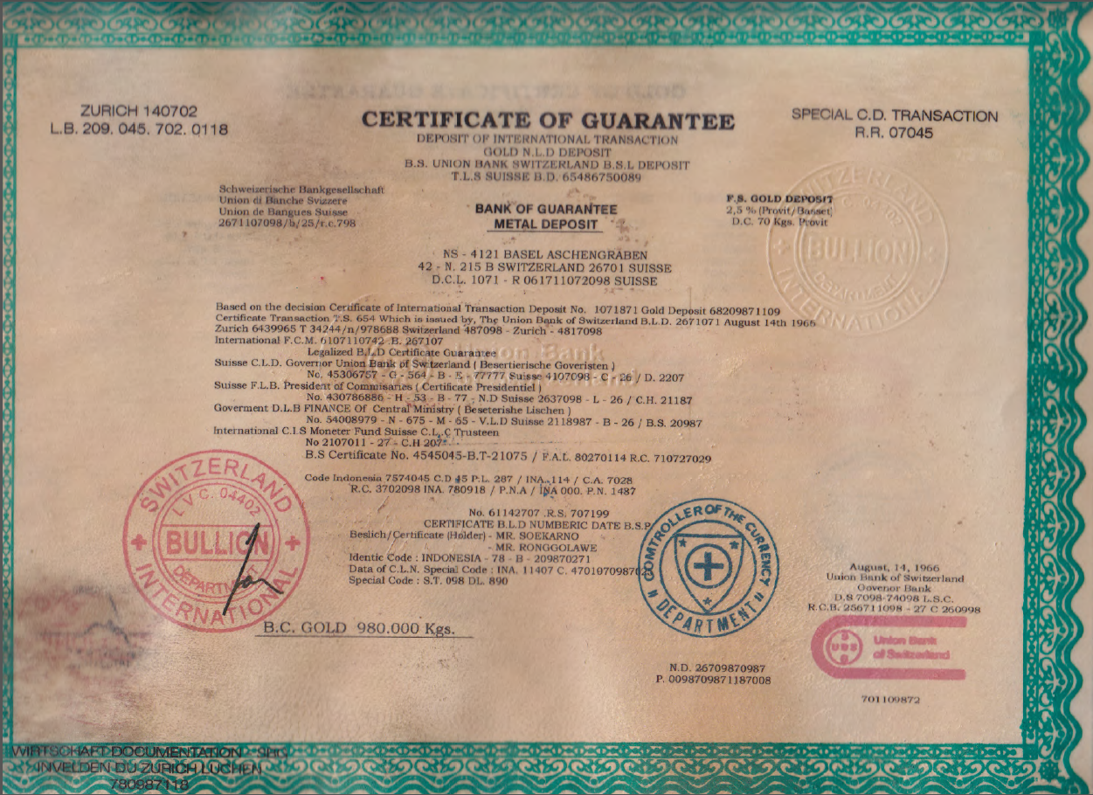
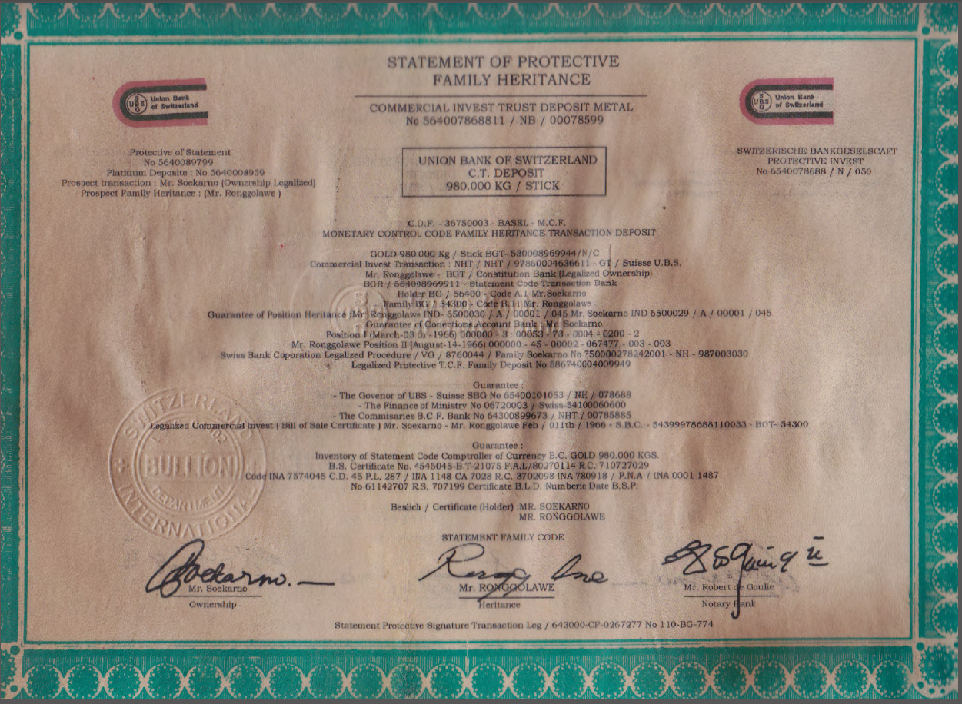
AMANAH’S ODYSSEY I CALL TO ADVENTURE: PROTECTIVE FAMILY HERITANCE
UBS GUARANTEE

Slide 12
AMANAH’S ODYSSEY I CALL TO ADVENTURE: 2011

Slide 13
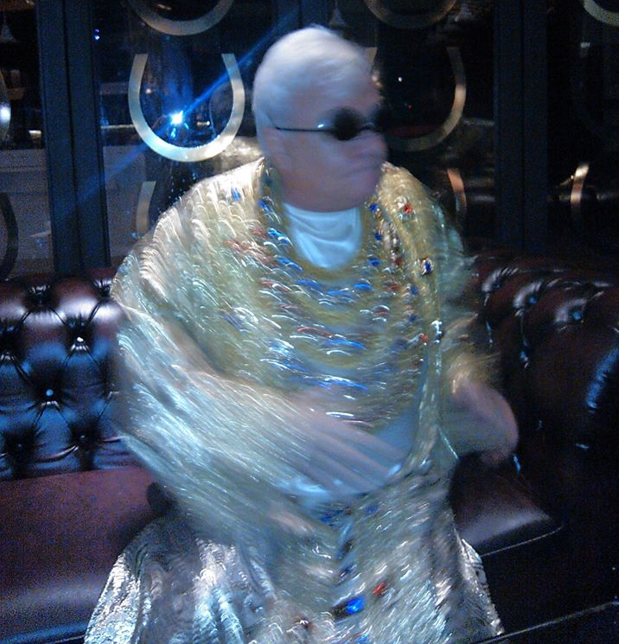
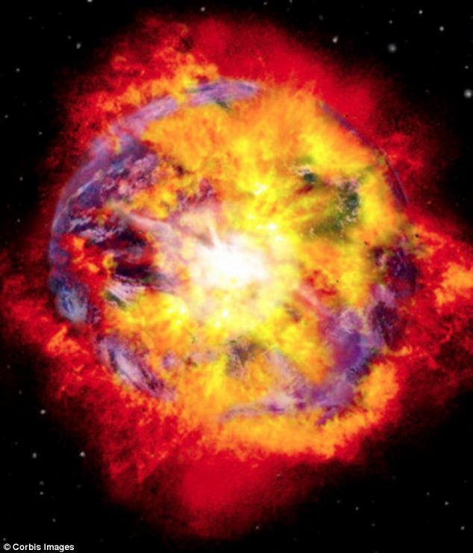
AMANAH’S ODYSSEY I CALL TO ADVENTURE: TRILLION DOLLAR LAWSUIT. 2011
…. And so, we begin the Amanah’s Odyssey THE ONE’s ‘Big Bang’ Trillion-Dollar Lawsuit…

Slide 14
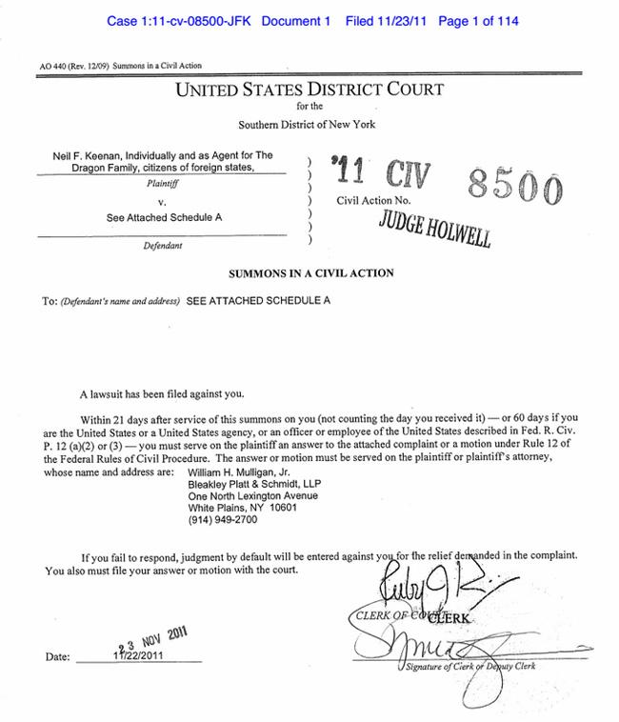
AMANAH’S ODYSSEY I CALL TO ADVENTURE: TRILLION DOLLAR LAWSUIT 2011

Slide 15
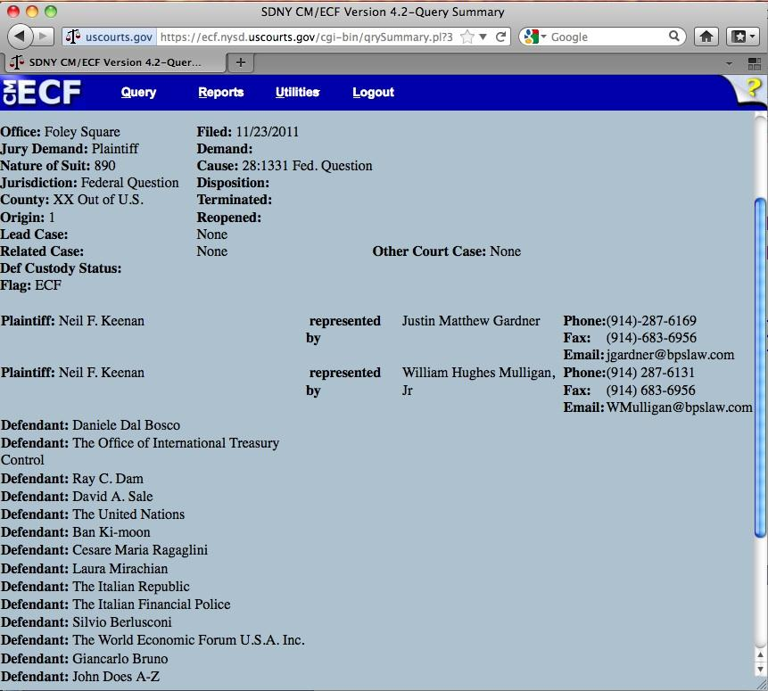
AMANAH’S ODYSSEY I CALL TO ADVENTURE: TRILLION DOLLAR LAWSUIT 2011

Slide 16
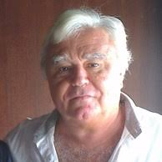
AMANAH’S ODYSSEY I CALL TO ADVENTURE: TRILLION DOLLAR LAWSUIT 2011
PLAINTIFF
NEIL FRANCIS KEENAN

Slide 17
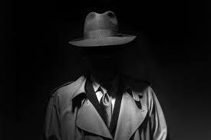
AMANAH’S ODYSSEY I CALL TO ADVENTURE: TRILLION DOLLAR LAWSUIT 2011
Defendant Daniele Dal Bosco

Slide 18
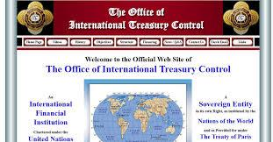
AMANAH’S ODYSSEY I CALL TO ADVENTURE: TRILLION DOLLAR LAWSUIT 2011
Defendant Office of International Treasury Control OITC

Slide 19
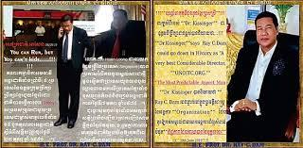
AMANAH’S ODYSSEY I CALL TO ADVENTURE: TRILLION DOLLAR LAWSUIT 2011
Defendant Ray Chhat Dam

Slide 20
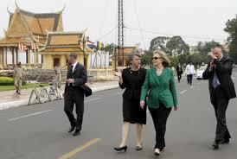
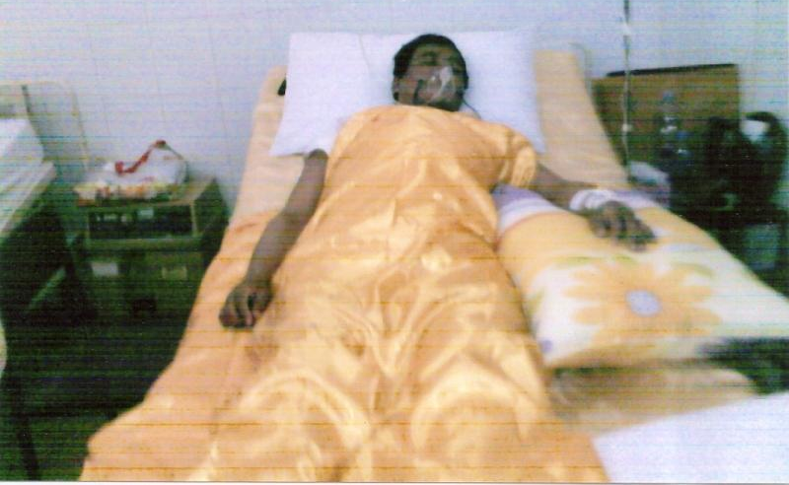
AMANAH’S ODYSSEY I CALL TO ADVENTURE: TRILLION DOLLAR LAWSUIT 2011
Hillary Clinton and Ambassador Rodly attempt on Ray C. Dam’s life

Slide 21
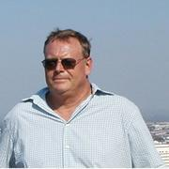
AMANAH’S ODYSSEY I CALL TO ADVENTURE: TRILLION DOLLAR LAWSUIT 2011
Defendant David A. Sale aka David Righter

Slide 22
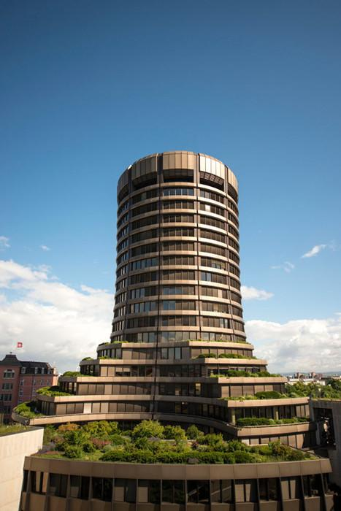
AMANAH’S ODYSSEY I CALL TO ADVENTURE: TRILLION DOLLAR LAWSUIT 2011
Defendant Bank of International Settlement (BIS)

Slide 23
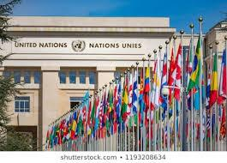
AMANAH’S ODYSSEY I CALL TO ADVENTURE: TRILLION DOLLAR LAWSUIT 2011
Defendant United Nations (UN)

Slide 24
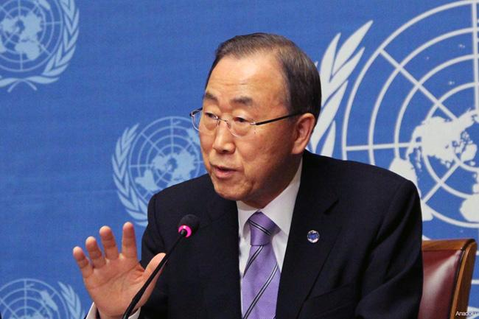
AMANAH’S ODYSSEY I CALL TO ADVENTURE: TRILLION DOLLAR LAWSUIT 2011
Defendant BAN KI-moon, UN Secretary General

Slide 25
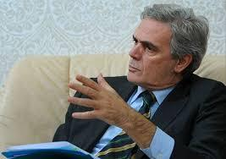
AMANAH’S ODYSSEY I CALL TO ADVENTURE: TRILLION DOLLAR LAWSUIT 2011
Defendant H.E. Ambassador Cesare Maria RAGAGLINI

Slide 26
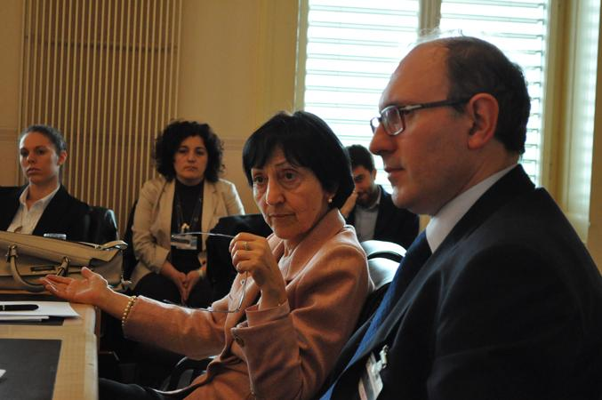
AMANAH’S ODYSSEY I CALL TO ADVENTURE: TRILLION DOLLAR LAWSUIT 2011
Defendant H.E. Ambassador Laura MIRACHIAN

Slide 27


AMANAH’S ODYSSEY I CALL TO ADVENTURE: TRILLION DOLLAR LAWSUIT 2011
Defendant The Italian Republic

Slide 28
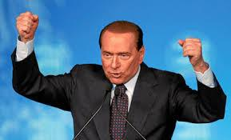
AMANAH’S ODYSSEY I CALL TO ADVENTURE: TRILLION DOLLAR LAWSUIT 2011
Defendant SILVIO BERLUSCONI, Prime Minister of Italy

Slide 29
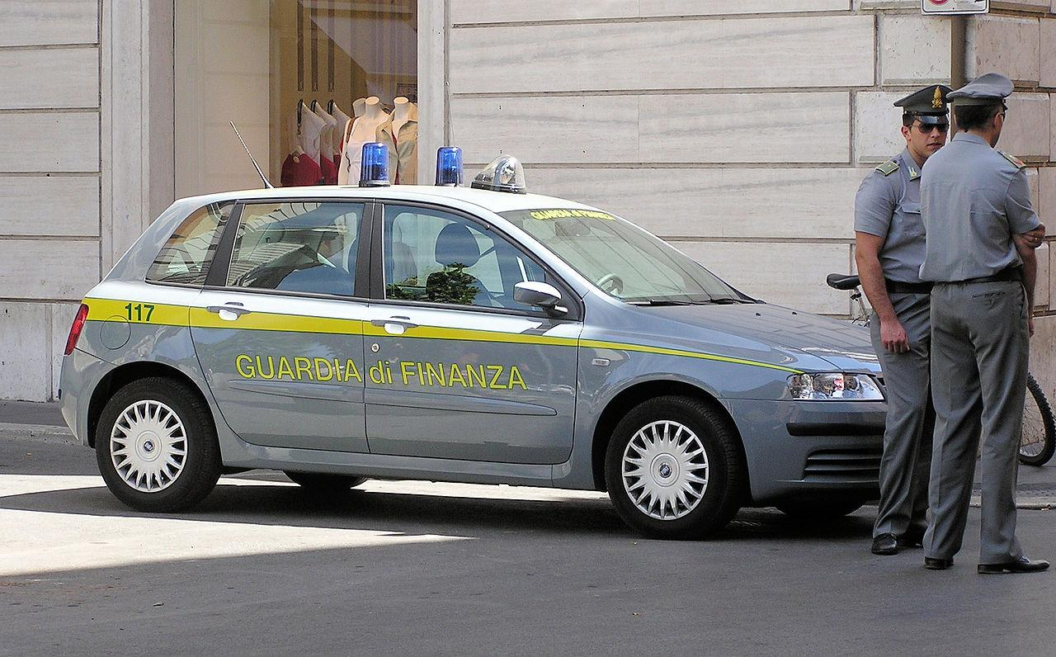
AMANAH’S ODYSSEY I CALL TO ADVENTURE: TRILLION DOLLAR LAWSUIT 2011
Defendant ITALIAN FINANCIAL POLICE

Slide 30

AMANAH’S ODYSSEY I CALL TO ADVENTURE: TRILLION DOLLAR LAWSUIT 2011
Defendant the World Economic Forum (WEF)

Slide 31
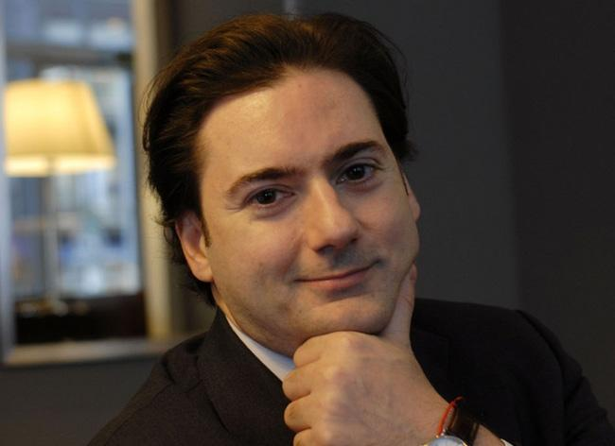
AMANAH’S ODYSSEY I CALL TO ADVENTURE: TRILLION DOLLAR LAWSUIT 2011
Defendant Giancarlo Bruno

Slide 32
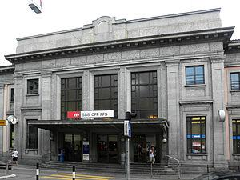
AMANAH’S ODYSSEY I CALL TO ADVENTURE: TRILLION DOLLAR LAWSUIT. 2011
Chiasso Italy Railway Bond Incident

Slide 33
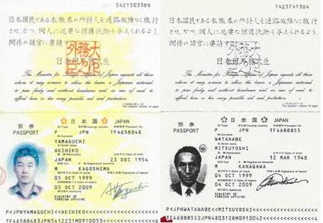
AMANAH’S ODYSSEY I CALL TO ADVENTURE: TRILLION DOLLAR LAWSUIT 2011
Akihiko Yamaguchi and Mitsuyoshi Watanabe

Slide 34
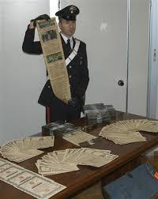
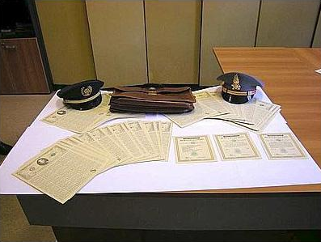
AMANAH’S ODYSSEY I CALL TO ADVENTURE: TRILLION DOLLAR LAWSUIT 2011
Chiasso Italy Bond Incident

Slide 35
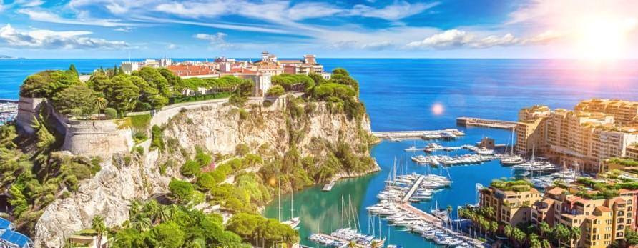
AMANAH’S ODYSSEY I CALL TO ADVENTURE: THE MONACO ACCORD 2011
Neil Keenan and 57 Finance Ministers “Monaco Accords” Colloquium

Slide 36
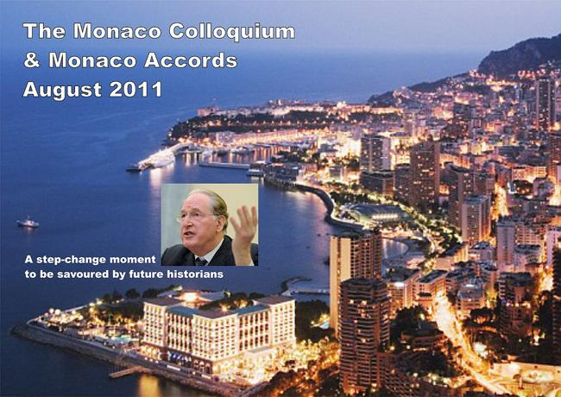
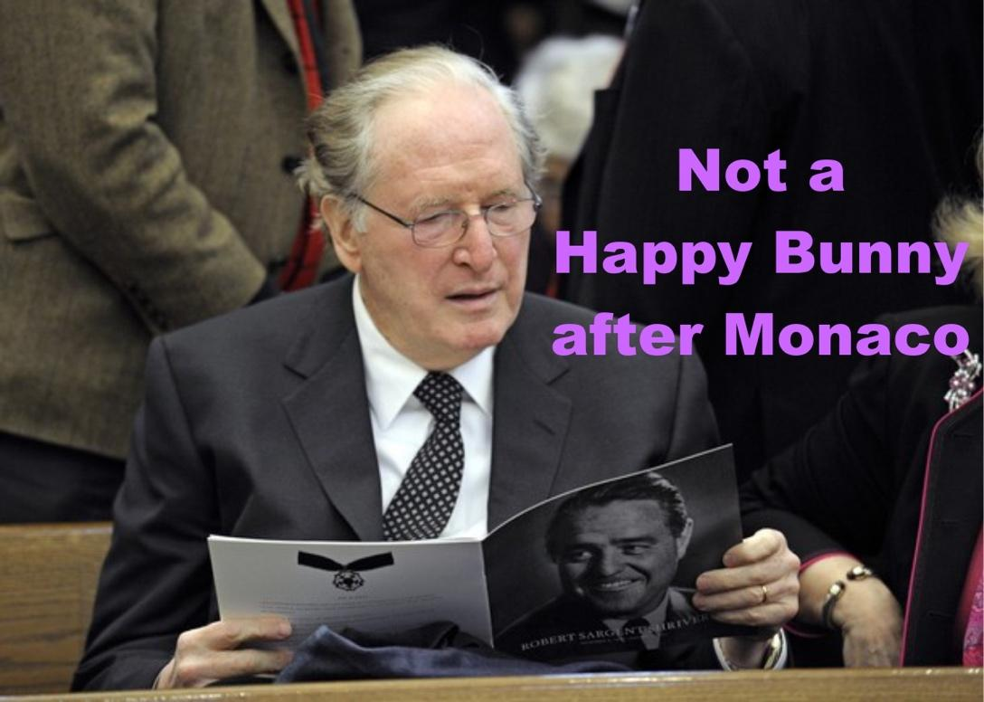
AMANAH’S ODYSSEY I CALL TO ADVENTURE: THE MONACO ACCORD 2011
When Rockefeller demanded “Don’t you know who I am?” Keenan responded, “Yes, you’re exactly the person we don’t want on this boat.”

Slide 37
AMANAH’S ODYSSEY I CALL TO ADVENTURE 2012

Slide 38
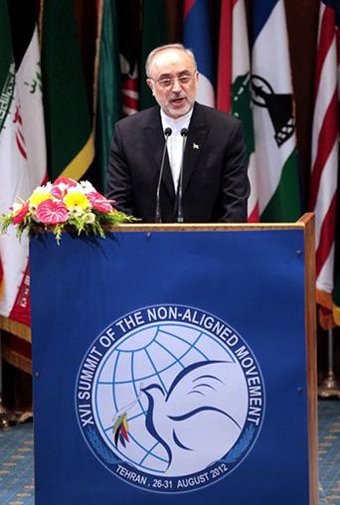
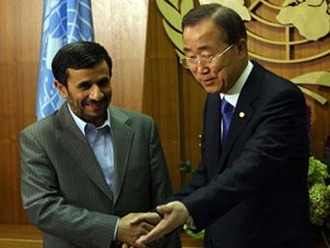
AMANAH’S ODYSSEY I CALL TO ADVENTURE: THE NON-ALIGNED MOVEMENT 2012
The Non-Aligned Movement (Members aka The Alliance)

Slide 39
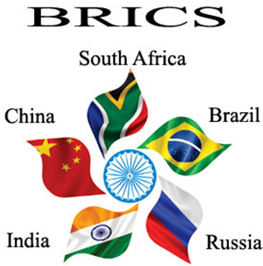
AMANAH’S ODYSSEY I CALL TO ADVENTURE: BRICS 2012

Slide 40
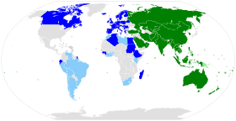

AMANAH’S ODYSSEY I CALL TO ADVENTURE: MONACO MORPHED INTO EASTERN AIIB Asian Infrastructure Investment Bank (AIIB) 2012

Slide 41
AMANAH’S ODYSSEY I | CALL TO ADVENTURE: AFFIDAVITS, LIENS, CEASE & DESIST ORDERS 2012
International businessmen, Neil Keenan filed individual Financial Liens with Cease and Desist Orders against the 12 Federal Reserve banks, the BIS, the European Central Bank, the National Bank of Belgium, the Bank of England, the Deutsche Bundesbank, the Bank of France, the Banca D’Italia, the Bank of Japan, the De Nederlandsche Bank, as well as a cease and desist against the United Bank of Switzerland and the BIS.

Slide 42
AMANAH’S ODYSSEY I | CALL TO ADVENTURE: AFFIDAVITS, LIENS, CEASE & DESIST ORDERS
This Cease and Desist Order is issued and effective from this 5th Day of January 2012 to all Parties specifically nominated and stated below:
* ACKERMANN, Josef / DEUTSCHE BANK
* BAN Ki-MOON, Secretary-General United Nations
* BANK FOR INTERNATIONAL SETTLEMENTS (BIS)
* BARCLAYS GROUP, London and Worldwide.
* BAROSSO, José Manuel D., President of the European Commission
* BERLUSCONI, Sylvio, former Prime Minister of Italy
* BERNANKE, Ben S., Chairman of the Board of Governors of the Federal Reserve
* BLAIR, Tony A.C.L., former Prime Minister of the United Kingdom
* BLANKFEIN, Lloyd C. / GOLDMAN SACHS
* BUSH Sr., George H.W., 41st President of the United States of America
* BUSH Jr., George W., 43rd President of the United States of America
* CAMERON, David W.D., Prime Minister of the United Kingdom
* CLINTON, Hillary D.R., United States Secretary of State
* CREDIT SUISSE (CS)
* DAVIGNON, Étienne F.J., former vice-president European Commission
* DIMON, James / JP MORGAN

Slide 43
AMANAH’S ODYSSEY I | CALL TO ADVENTURE: AFFIDAVITS, LIENS, CEASE & DESIST ORDERS
This Cease and Desist Order is issued and effective from this 5th Day of January 2012 to all Parties specifically nominated and stated below:
DRAGHI, Mario, President of the European Central Bank (/ex-GOLDMAN SACHS)
* EMANUEL, Rahm I., Mayor of Chicago
* FEDERAL RESERVE SYSTEM and all CENTRAL BANKS
* GEITHNER, Timothy F., United States Secretary of the Treasury
* GREENSPAN, Alan, 13th Chairman of the Board of Governors of the Federal Reserve
* HSBC GROUP
* INTERNATIONAL MONETARY FUND (IMF)
* KISSINGER, Henry A.
* MONTI, Mario, Prime Minister of Italy (/ex-GOLDMAN SACHS)
* NETANYAHU, Benjamin “Bibi”, Prime Minister of Israel
* PAPADEMOS, Lucas, Prime Minister of Greece (/ex-GOLDMAN SACHS)
* PAULSON, Henry “Hank” M., former United States Secretary of the Treasury (74th)
* QUEEN ELIZABETH II. / HOUSE of WINDSOR, The United Kingdom & Commonwealth
* QUEEN BEATRIX / HUIS van ORANJE, The Netherlands
* ROCKEFELLER, David Sr.
* ROCKEFELLER, John “Jay” D. IV

Slide 44
AMANAH’S ODYSSEY I | CALL TO ADVENTURE: AFFIDAVITS, LIENS, CEASE & DESIST ORDERS
This Cease and Desist Order is issued and effective from this 5th Day of January 2012 to all Parties specifically nominated and stated below:
ROMNEY, W. Mitt
* ROMPUY van, Herman A., President of the European Council
* ROTHSCHILD de, Evelyn R.A.
* ROTHSCHILD de, David M.
* RUBIN, Robert E., former United States Secretary of the Treasury (70th)
* SARKOZY, Nicolas, President French Republic
* SOROS, George
* SUMMERS, Lawrence “Larry” H., former Director of the National Economic Council (USA)
* UNION BANK OF SWITZERLAND (UBS)
* UNITED NATIONS
* WOOTTON, David, Lord Mayor CITY OF LONDON
* WORLD BANK (International Bank for Reconstruction and Development)
* ALL GOVERNMENT offices in the United States, Germany, Great Britain, Italy, The Netherlands, Belgium, France and Japan;

Slide 45
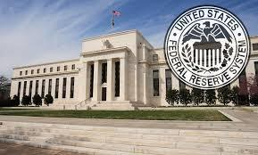
AMANAH’S ODYSSEY I | CALL TO ADVENTURE: AFFIDAVITS, LIENS, CEASE & DESIST ORDERS 2012
LIEN Affidavit against the US Federal Reserve Board

Slide 46
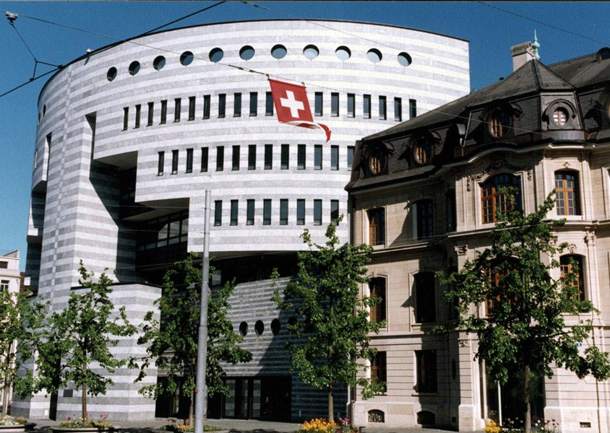
AMANAH’S ODYSSEY I | CALL TO ADVENTURE: AFFIDAVITS, LIENS, CEASE & DESIST ORDERS 2012
LIEN Affidavit against the Bank for International Settlements (BIS)

Slide 47
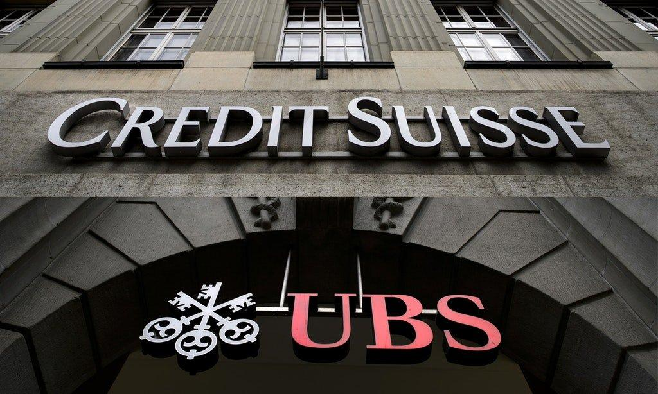
AMANAH’S ODYSSEY I | CALL TO ADVENTURE: AFFIDAVITS, LIENS, CEASE & DESIST ORDERS 2012
Cease and Desist Order to the Union Bank of Switzerland (UBS) and the Bank for International Settlements

Slide 48
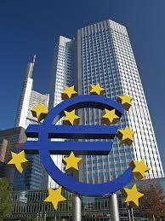
AMANAH’S ODYSSEY I | CALL TO ADVENTURE: AFFIDAVITS, LIENS, CEASE & DESIST ORDERS 2012
LIEN Affidavit against the European Central Bank (ECB)

Slide 49
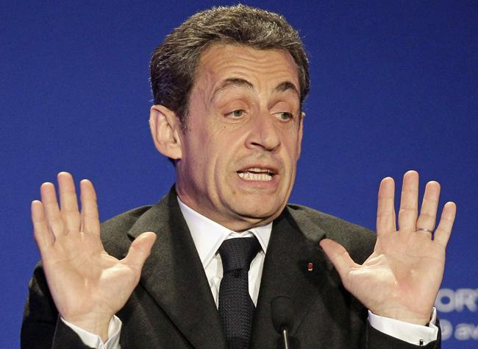
AMANAH’S ODYSSEY I | CALL TO ADVENTURE: DISPATCHES & RESIGNATIONS 2012
First, Former President of France Nicolas Sarkozy: Dispatched courtesy of the efforts of Neil Keenan

Slide 50
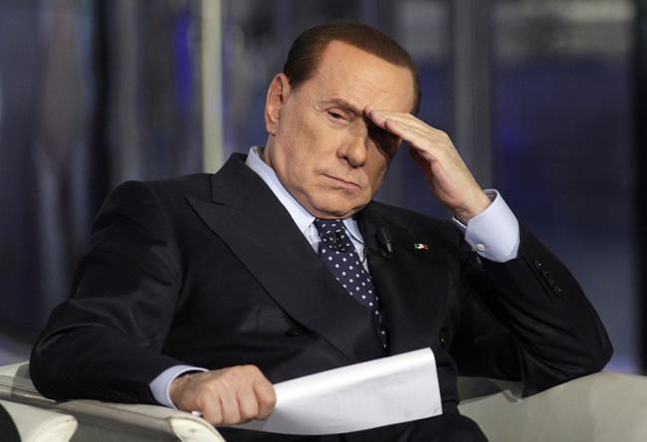
AMANAH’S ODYSSEY I | CALL TO ADVENTURE:
DISPATCHES AND RESIGNATIONS 2012
Second, Former Prime Minister of Italy Silvio Berlusconi: Dispatched courtesy of the efforts of Neil Keenan

Slide 51
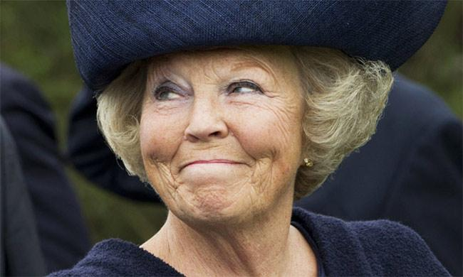
AMANAH’S ODYSSEY I | CALL TO ADVENTURE:
DISPATCHES AND RESIGNATIONS 2012
Third, Former Queen Beatrix of The Netherlands: Dispatched courtesy of the efforts of Neil Keenan

Slide 52
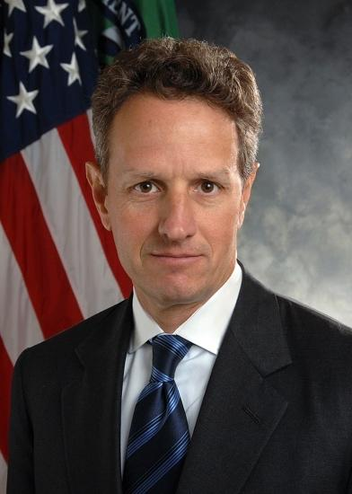
AMANAH’S ODYSSEY I | CALL TO ADVENTURE:
DISPATCHES AND RESIGNATIONS 2012
Fourth Timothy Geithner former Secretary of U.S. Treasury : Dispatched courtesy of the efforts of Neil Keenan

Slide 53
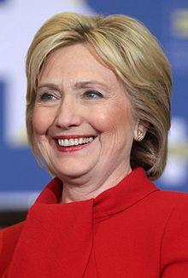
AMANAH’S ODYSSEY I | CALL TO ADVENTURE:
DISPATCHES AND RESIGNATIONS 2012
Fifth Hillary Clinton former U.S. Secretary of State: Dispatched courtesy of the efforts of Neil Keenan

Slide 54
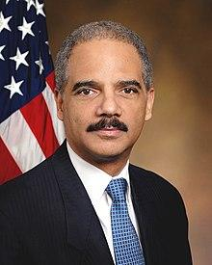
AMANAH’S ODYSSEY I | CALL TO ADVENTURE:
DISPATCHES AND RESIGNATIONS 2012
Sixth Eric Holder former Attorney General: Dispatched courtesy of the efforts of Neil Keenan

Slide 55
AMANAH’S ODYSSEY I CALL TO ADVENTURE: ‘LIGHTS OUT’ BACKSTORIES

Slide 56

AMANAH’S ODYSSEY I CALL TO ADVENTURE: ‘LIGHTS OUT’ BACKSTORIES
Stolen Bonds Foiled Funding for New Years Eve Free Energy Debut at Vatican

Slide 57


AMANAH’S ODYSSEY I CALL TO ADVENTURE: ‘LIGHTS OUT’ BACKSTORIES
Backstory: Benjamin Fulford and Leo Zagami

Slide 58

AMANAH’S ODYSSEY I CALL TO ADVENTURE: ‘LIGHTS OUT’ BACKSTORIES
Keenan Contributed Content to Financial Tyranny Book

Slide 59


AMANAH’S ODYSSEY I CALL TO ADVENTURE: ‘LIGHTS OUT’ BACKSTORIES
Backstory: Keith Scott, former OITC Chief of Cabinet

Slide 60

AMANAH’S ODYSSEY I CALL TO ADVENTURE: ‘LIGHTS OUT’ BACKSTORES
Peter Wagoner alias Rockefeller’s Nephew and Prince

Slide 61

AMANAH’S ODYSSEY I CALL TO ADVENTURE: ‘LIGHTS OUT’ BACKSTORIES
Christine Lagarde former head of IMF and President of the European Central Bank

Slide 62


AMANAH’S ODYSSEY I CALL TO ADVENTURE: ‘LIGHTS OUT’ BACKSTORIES
Keenan catches IMF-Goldman Sachs Laundering Funds

Slide 63

AMANAH’S ODYSSEY I CALL TO ADVENTURE: ‘LIGHTS OUT’ BACKSTORIES
Leon Wanta Funds “Eagle One to Wanta” $27 TRILLION

Slide 64

AMANAH’S ODYSSEY I CALL TO ADVENTURE: ‘LIGHTS OUT’ BACKSTORIES
Lord Blackheath’s United Kingdom Parliament Announcement of Foundation X Trillion Dollar Proposal

Slide 65
AMANAH’S ODYSSEY I CALL TO ADVENTURE: ‘LIGHTS OUT’ BACKSTORIES 2012
Wow! Thanks to all for putting up with me day and night for years, especially during the times when I had no idea what I was doing. Those days are long behind me now, and they’re nothing more than good memories. There are so many things for me to look back at and say, “Did I do that?” Sometimes I just shake my head.
Yes, there is so much more to do once this phase is finally in order. You will find me securely walking away from what was built from the lawsuit on up. We have not seen anything to completion yet, so don’t get carried away with anything. Once it is done, this is what I expect to see: I will be around as per mandate, but let’s let the others enjoy the show when they can.
Neil Keenan

